Slide 1
Filtration across the glomerulus and membrane chip design
Liev (Lev) Birman

Slide 2
Glomerular Membrane Physics
- The main layers of the glomerulus
- Pressure driven flow
- Electrical interactions

Slide 3
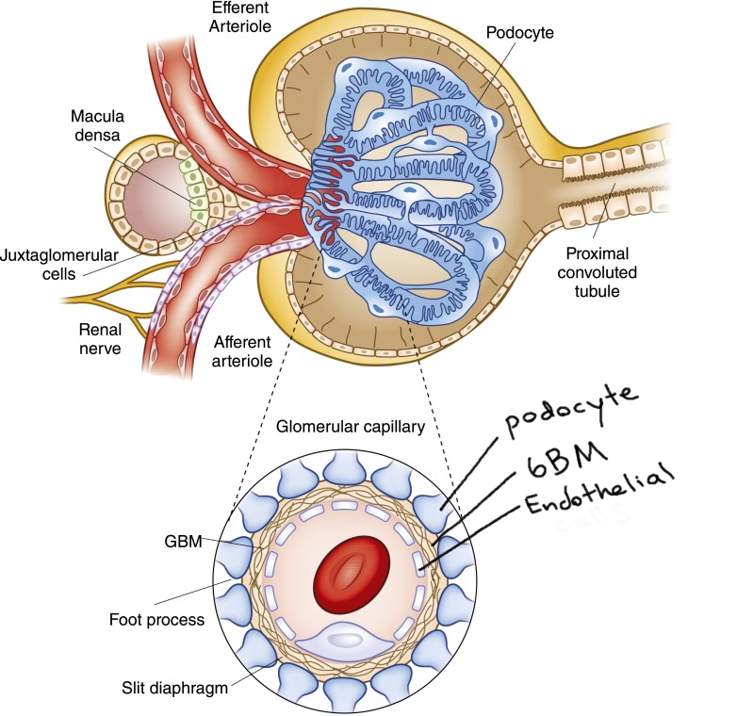
Layers of the glomerulus
Glomerulus endothelial are fenestrated (highly porous) and plugged with glycocalyx-like material (made from collagens, laminins, and more proteins) 60-100nm diameter and 20% coverage
GBM is fibrous. 2-pore model. 4nm and 8nm pores
Albumin size: 8 x 8 x 3nm
Image:
Pollak et al. Clin J Am Soc Nephrol.
2014 Aug 7; 9(8): 1461-1469

Slide 4
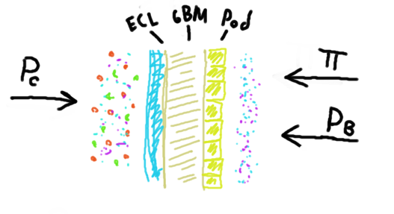
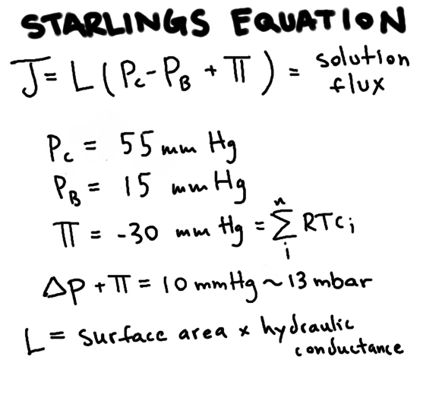
Pressure Driven Flow and Filtration
~8 nl/min/mmHg

Slide 5
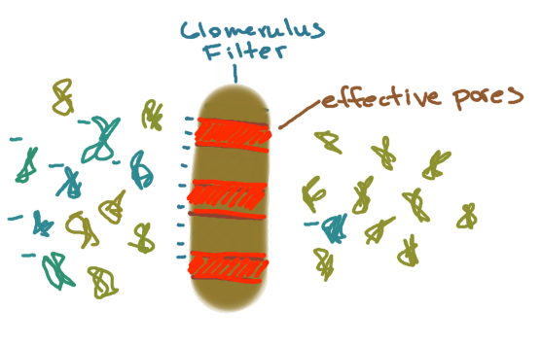
Electrostatic Effects
Neutral Albumin will pass through this membrane 10x more readily than native (negatively charged) Albumin due to charge selection. This also explains why the filter never clogs.
Moeller & Tenten Nat. Rev. Nephrol. 9, 266-277(2013)
Precise mechanism of
charge selection unknown.

Slide 6
Membrane Chip and Glomerular Filtration
- Pressures and velocities inside of the chip
- Comparison to glomerular physiology
- Discussion: Chip modification
Can we mimic the physiological conditions at the glomerulus?

Slide 7
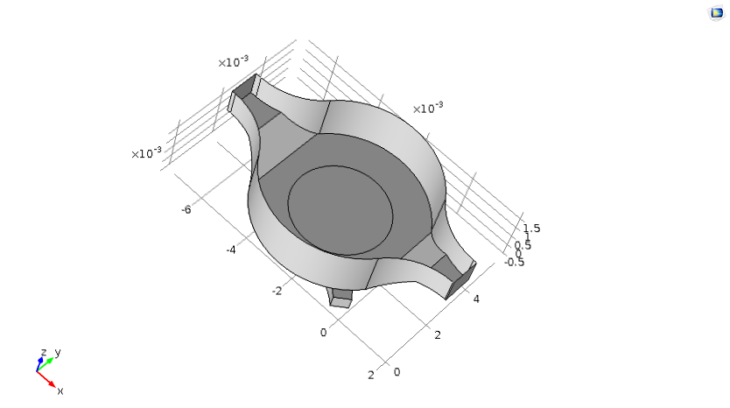
3D COMSOL Simulation What pressures does our on-chip membrane actually experience?

Slide 8

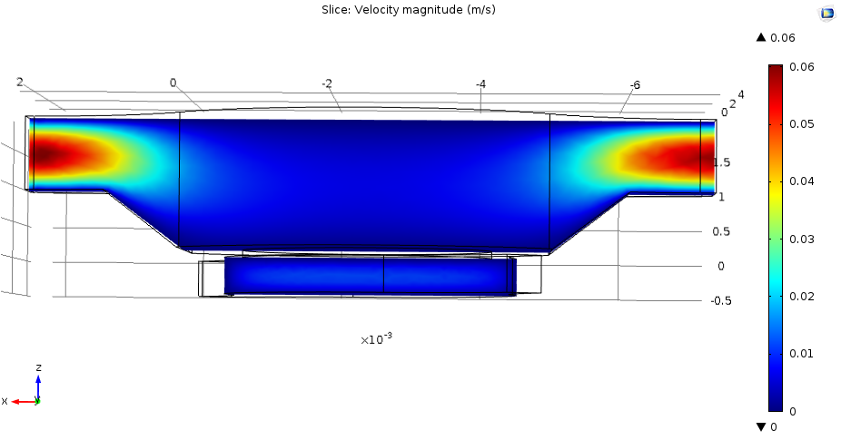
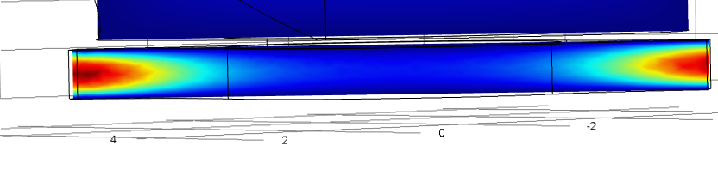
Laminar Flow

Slide 9
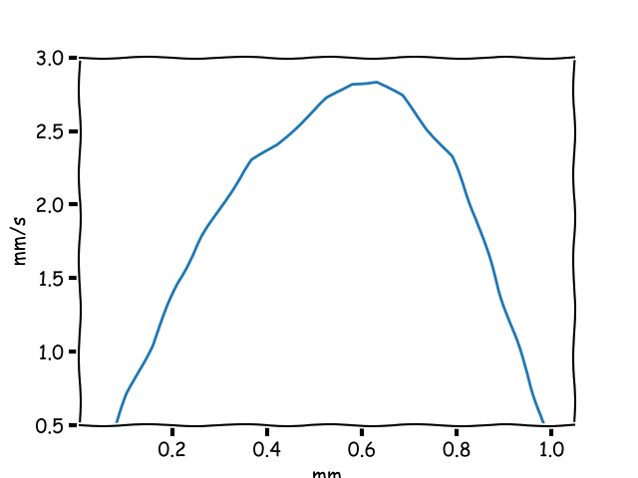
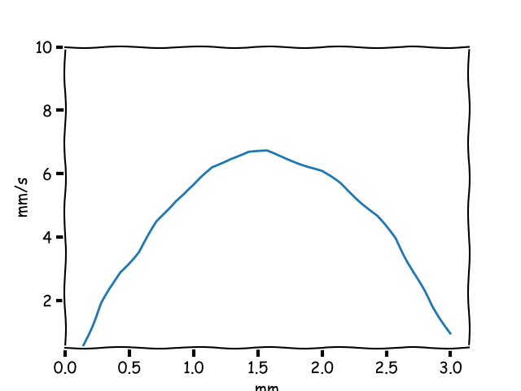
Predicted Velocity Profiles
Lower (Capillary) Channel Velocity Profile
Upper (Bowman’s) Channel Velocity Profile
Note: The scaling is a bit misleading. The plot on the right shows a much higher max velocity

Slide 10
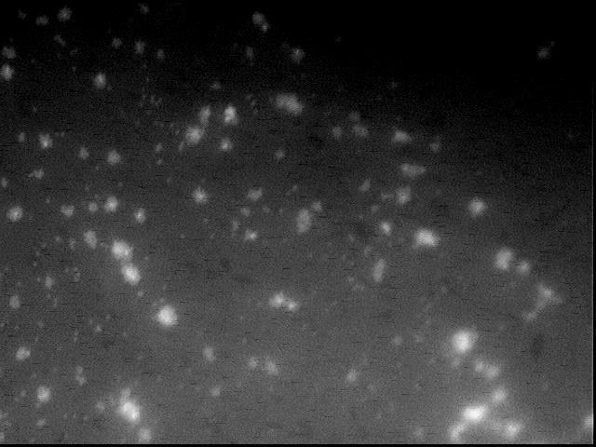
Particle Imaging Velocimetry i.e. Fluorescent Particle Tracking Can we validate the COMSOL simulation?
These are beads clumped on the membrane. Sorry no scale bars. Pores are 0.4 microns for reference

Slide 11
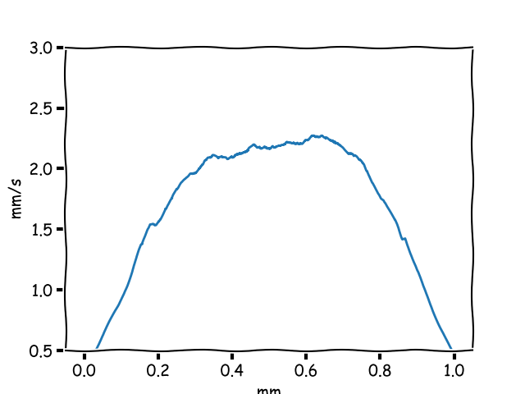
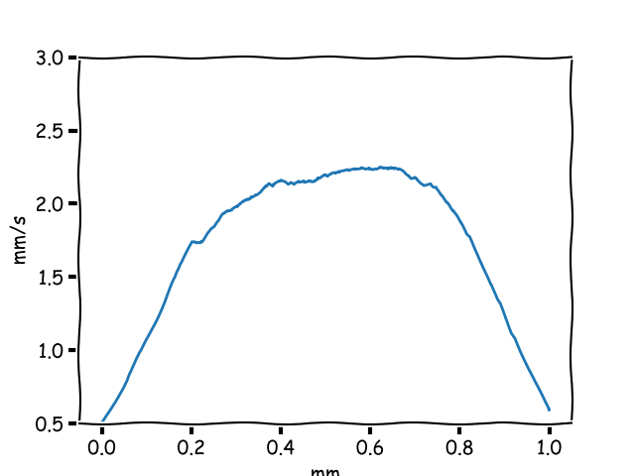
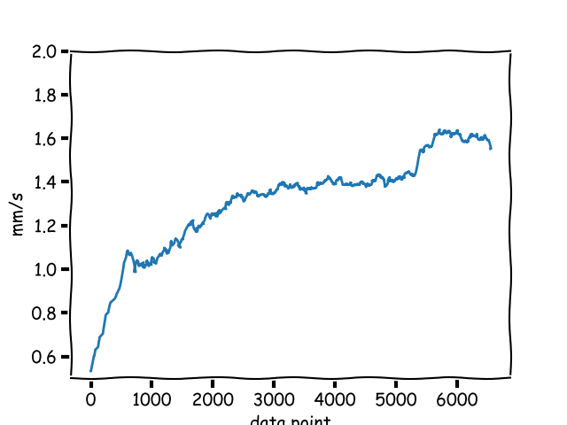
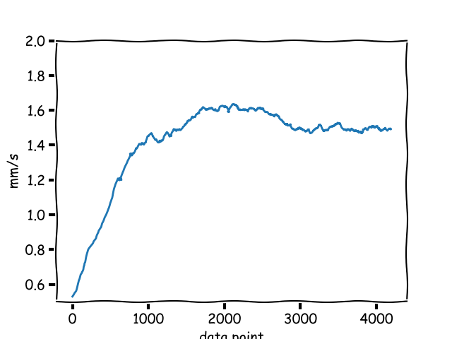
Measured Velocity Profiles
Lower Channel @ 20mbar
Lower Channel @ 30mbar
Upper Channel @ 20 mbar
Upper Channel @ 30 mbar

Slide 12
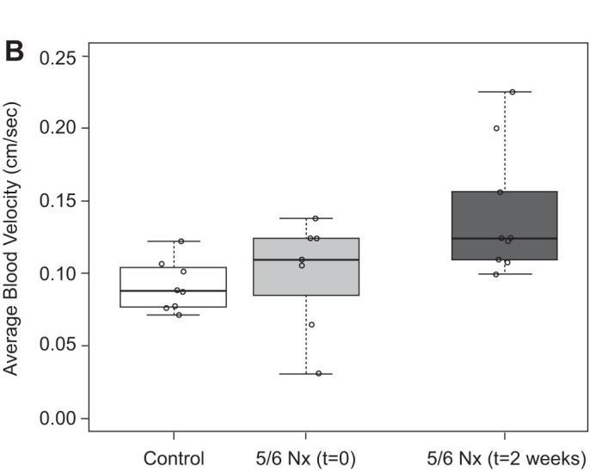
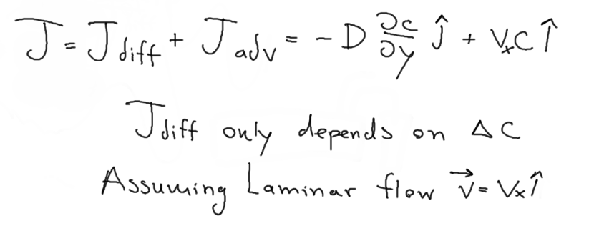
Side Note: Physiological Velocities
This study on high blood pressure says that our
measured velocities are seen in rats with high
blood pressure.
Will this effect our physiomimickery?
Taken from: Ferrell et al.
AM J Renal Physiol 2015 Mar 15; 308(6) F588-F593
Animal: Male Simenson Munich-Wistar rats Nephrectomy
As long as our pressure drop is physiological
and there is no subtler phenomena occurring
then we should be ok

Slide 13
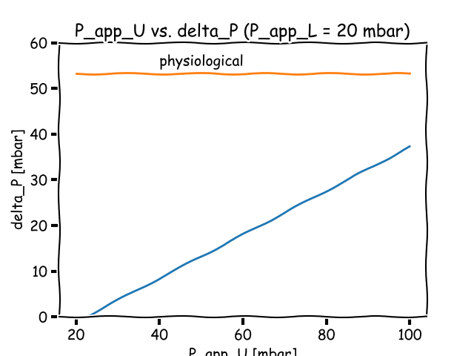
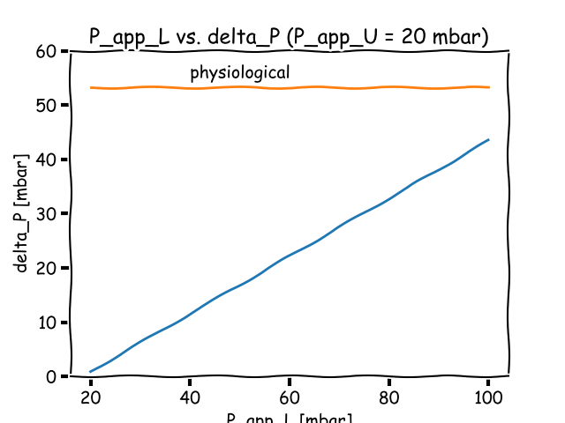
Simulated Pressures (From validated COMSOL model)
The physiological hydrostatic pressure drop is 40 mmHG ~ 52mbar.
The pressure shown here is only hydrostatic (not oncotic)
Our pressures are low.

Slide 14
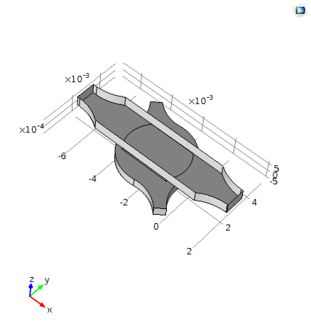
Attempt at Chip Slimming
Volume decreased
by nearly 0.5.

Slide 15
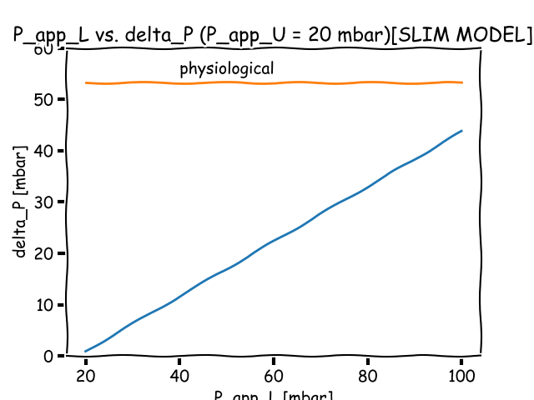
Simulated Pressures (Thin Chip)
Hardly any difference.

Slide 16
All are options
1st Step: Double Check Calculations
2nd Step: Change system parameters (If calculations are correct)
Do we need to crank up the pressure pumps?
Do we need to scale down by an order of magnitude?

Slide 17
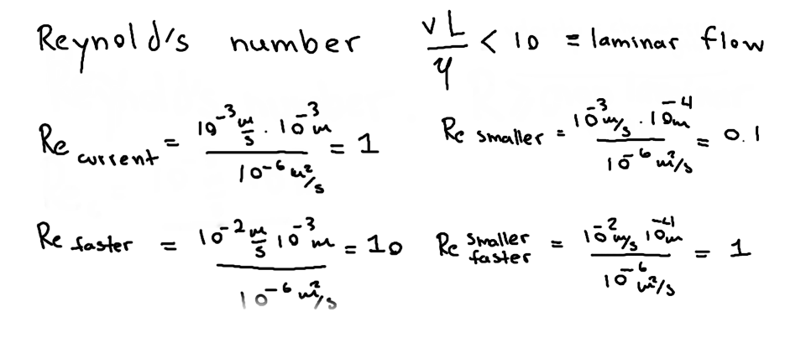
Applying Higher Pressure

Slide 18
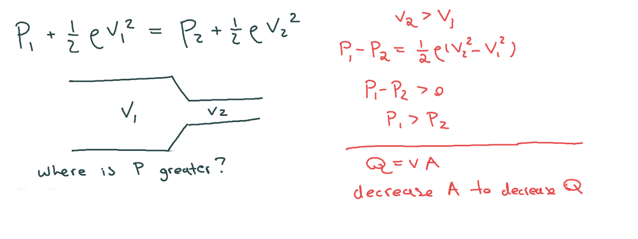
Scaling Down

Slide 19
Summary
The Glomerulus filters via size and charge and is pressure driven
COMSOL model of flow has shown that our pressure is too low
Scaling system down might prove beneficial

